Slide 1

AI-Based Network Intrusion Detection System
THANNUSREE RAJASEKAR
[AICTE ID :APPLY_176269697069109f0a1e886 ]

Slide 2

PROBLEM STATEMENT
Modern networks face increasing cyber attacks that cannot be effectively detected using traditional rule-based security systems. This project aims to develop an AI-based Network Intrusion Detection System that automatically identifies malicious network traffic using machine learning.

Slide 3
Project Description
The AI-Based Network Intrusion Detection System is designed to improve network security by automatically detecting malicious activities in network traffic. Traditional rule-based security systems are often ineffective against modern cyber attacks, so this project uses machine learning to identify intrusions efficiently.
The system is developed using Python and the Random Forest algorithm to classify network traffic as normal or malicious. A real-time dashboard built with Streamlit displays detection results and performance metrics, making the system easy to monitor and understand.

Slide 4

WHO ARE THE END USERS?
The end users of the AI-Based Network Intrusion Detection System include:
Network administrators to monitor and protect network traffic
Cybersecurity professionals for intrusion detection and threat analysis
Organizations and enterprises to enhance network security
Educational institutions and students for learning and research purposes

Slide 5

Technology Used
The end users of the AI-Based Network Intrusion Detection System include:
Network administrators to monitor and protect network traffic
Cybersecurity professionals for intrusion detection and threat analysis
Organizations and enterprises to enhance network security
Educational institutions and students for learning and research purposes

Slide 6
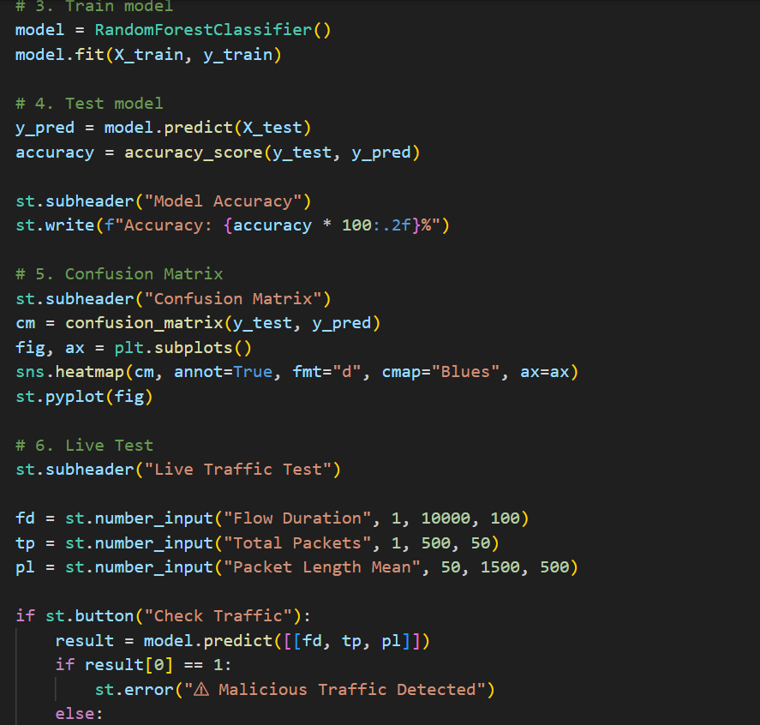
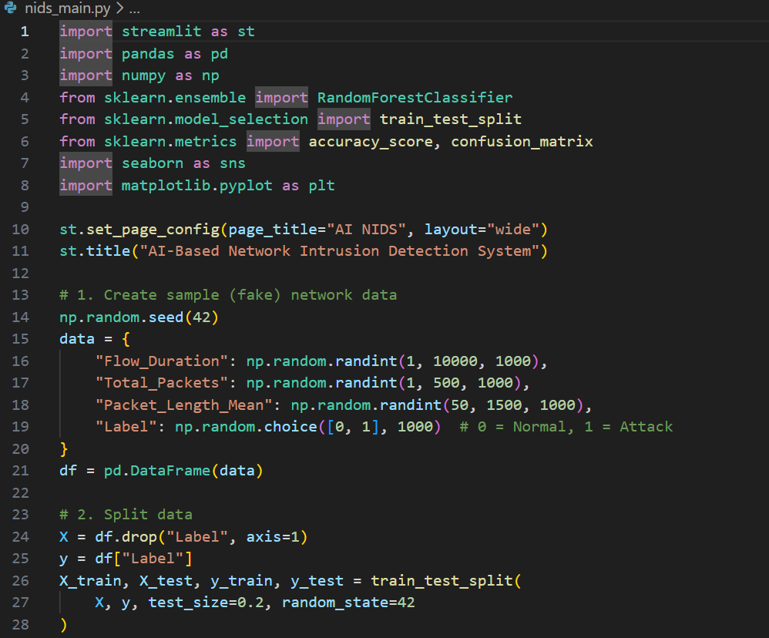
RESULTS
[Add screen shots of your code ]
https://github.com/thanusreerrr/AI-Based-Network-Intrusion-Detection-System

Slide 7
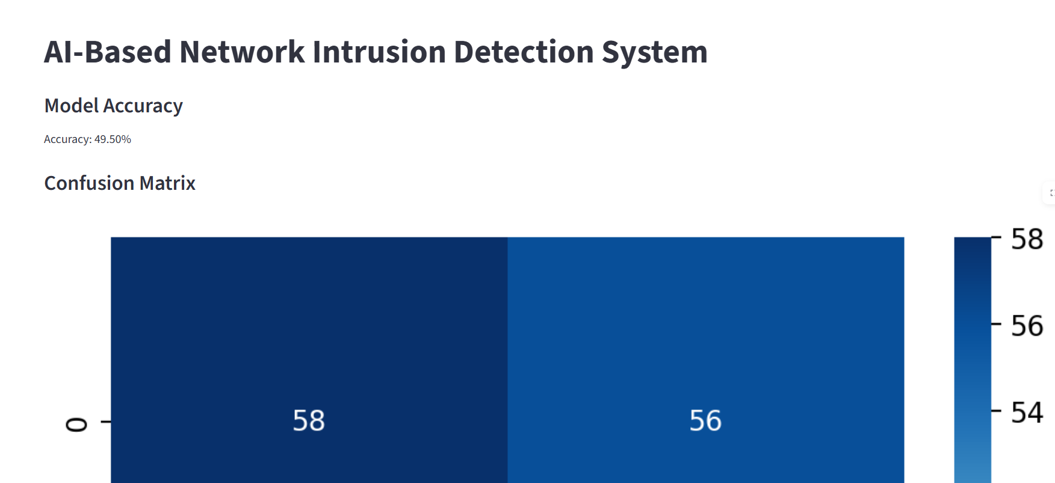
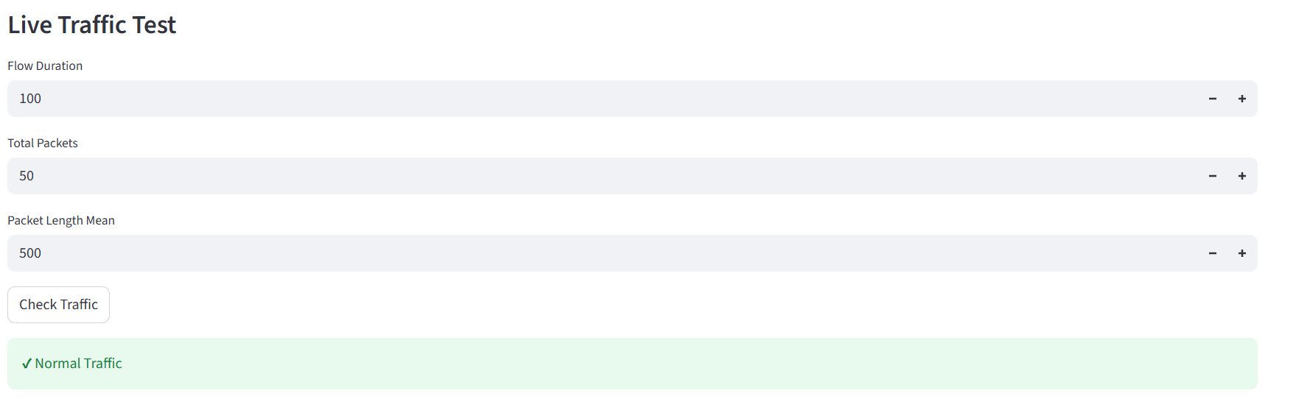
RESULTS
screen hots of your code ]

Slide 8

Certificate - Protection from browser attacks

Slide 9

Certificate - Introduction to System Security

Slide 10

Certificate - Securing Android Devices

Slide 11
GitHub link
https://github.com/thanusreerrr/AI-Based-Network-Intrusion-Detection-System.git

Slide 12
Thank you
.
.

